Slide 1

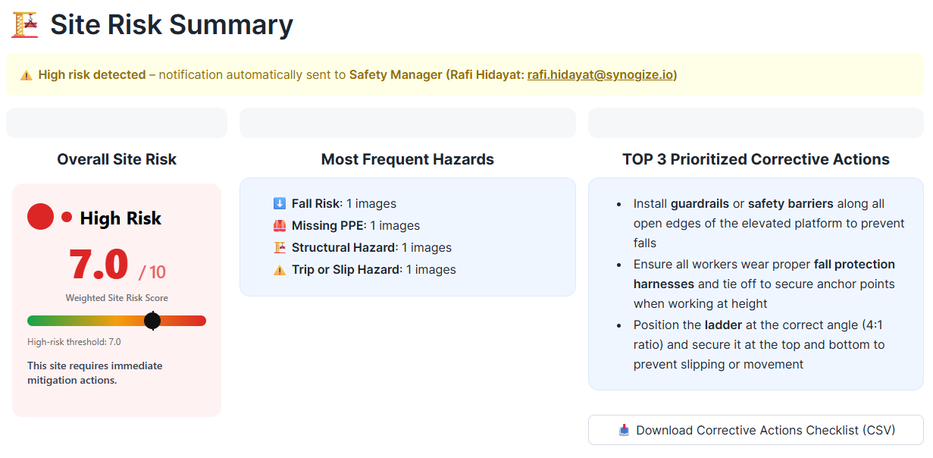

AI-Powered Site Safety Hazard & Risk Inspection using Snowflake AISQL
Internal AISQL Competition
By: Rafi Hidayat
January 2026

Slide 2


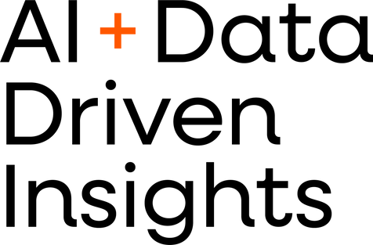
03 | Problem Statement
04 | Proposed Solution
05 | Solution Architecture & Data Flow
06 | Snowflake AISQL in Action
07 | Application Demo
12 | Reflection: What Worked Well
13 | Reflection: Challenges & Limitations
14 | Business Value & Impact
15 | Demo Link & Next Steps
Agenda

Slide 3
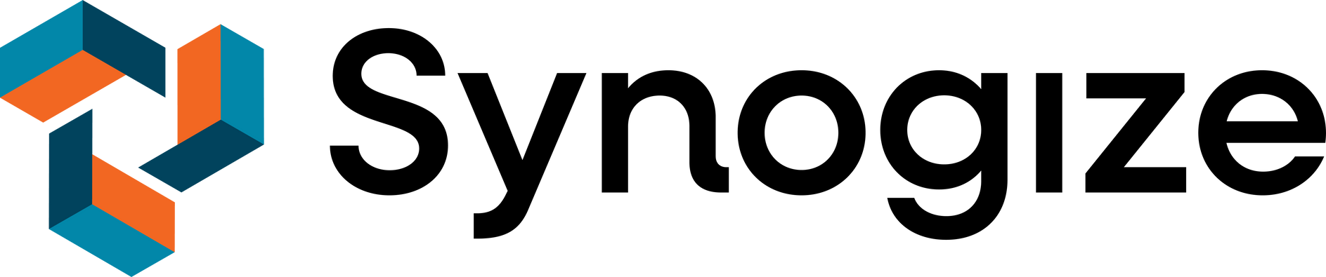
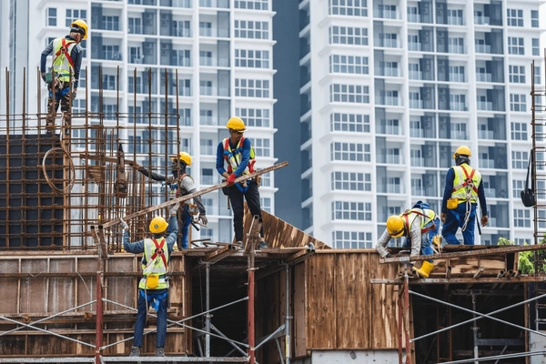

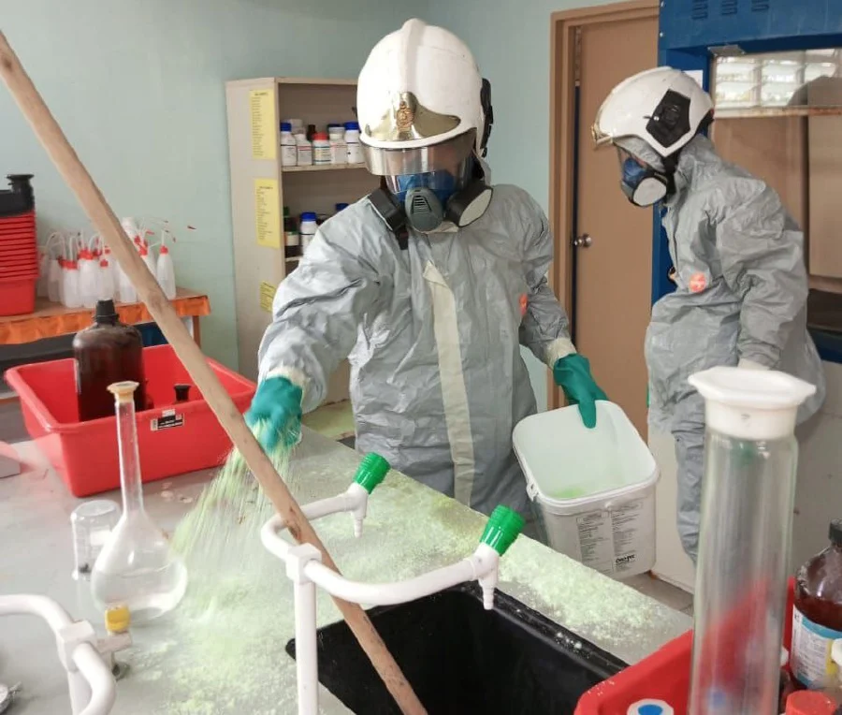
Problem Statement
Malaysia Workplace Safety Snapshot (2023)
38,950 occupational injury cases, a 13.8% increase from 2022
324 fatal work-related injuries recorded nationwide
Injury rate increased to 2.46 per 1000 workers
Source: Department of Statistics Malaysia, National Occupational Injury and Disease Statistics 2023
Despite established safety procedures and inspections, workplace injury and fatality rates in Malaysia continue to rise. Research on Malaysian construction sites shows that inadequate safety checks, missed hazard identification, unsafe work at height, and improper use of PPE are common contributors to accidents, indicating that improving the effectiveness of safety inspections plays an important role in reducing workplace risk (Manzoor et al., 2021).
Key Challenges in Site Safety Inspections
Inspections are often manual, periodic, and resource-intensive
Hazard identification relies heavily on human observation and experience
Coverage may be inconsistent across sites and inspection cycles
Findings are not always captured, aggregated, or acted on in real time
Historical inspection data is rarely used for trend analysis or proactive risk prevention
“Organizations increasingly require faster hazard detection, consistent risk scoring, and actionable corrective insights”

Slide 4
Proposed Solution:
AI-Assisted Site Safety Inspection
An AI-powered application that assists site safety inspections by analyzing site inspection images, identifying hazards, and generating risk insights in near real time
Key Capabilities:
Upload site inspection images from multiple site’s spots
Automatically screen images for potential safety hazards
Identify and classify multiple hazard types per image
Generate standardized risk scores and explanations
Recommend actionable corrective measures
Aggregate image-level results into site-level risk insights
Trigger automated alerts and generate shareable safety reports for immediate action

Slide 5
Solution Architecture & Data Flow
How it works?
User → image upload
1.
Image ingestion
Safety inspection images from different site spots are uploaded through a Streamlit application and stored in an internal Snowflake stage
Snowflake internal stage
2.
AI-based pre-screening (AI_FILTER)
Images are automatically screened to identify whether potential safety hazards exist, filtering out non-actionable images early to reduce unnecessary AI processing
AI_FILTER
3.
Hazard analysis & classification (AI_CLASSIFY)
Actionable images are analyzed to detect and classify multiple hazard categories (e.g. fall risk, PPE issues, fire hazards)
AI_CLASSIFY + AI_COMPLETE
4.
Risk assessment & explanation (AI_COMPLETE)
5.
The system generates standardized risk scores and concise explanations based on visible site conditions
Aggregation & History Tables
Corrective action generation (AI_COMPLETE)
6.
Actionable recommendations are produced for each identified hazard
Site-level aggregation & insights
Alerts + Report + Checklist
7.
Image-level results are aggregated to compute overall site risk, recurring hazards, and prioritized corrective actions
Historical risk tracking & trend analysis
8.
Site risk scores and hazard frequencies are persisted to build a historical risk profile and track trends across inspections
Operational outputs
High-risk sites trigger automated email alerts, while corrective action checklists and inspection reports are generated for sharing and audit purposes

Slide 6

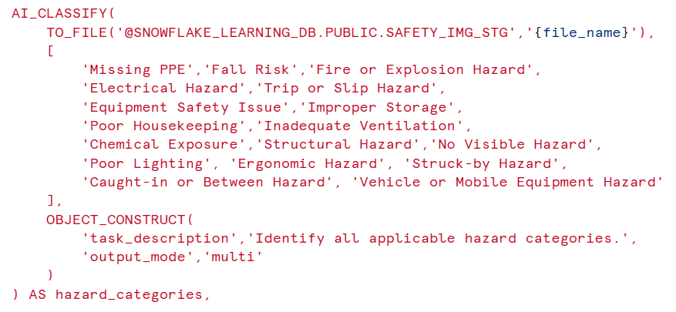
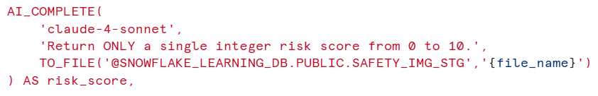
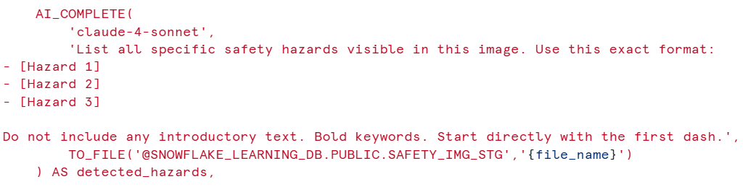
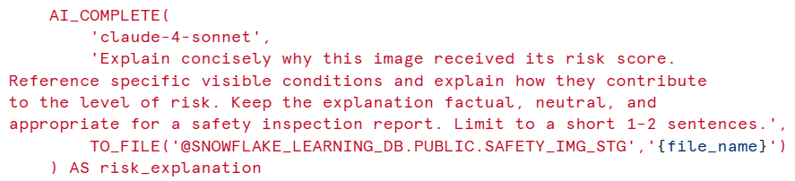
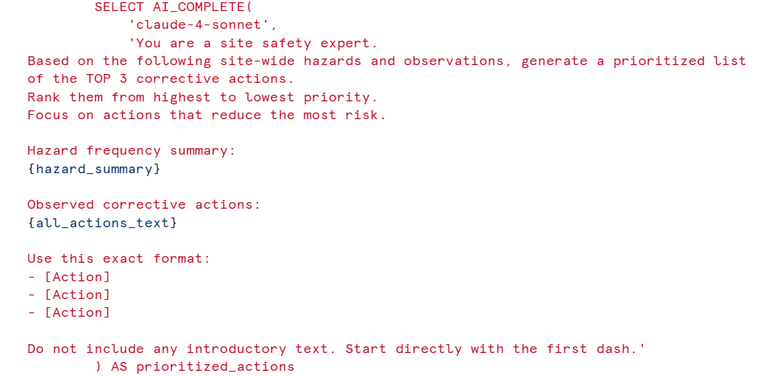
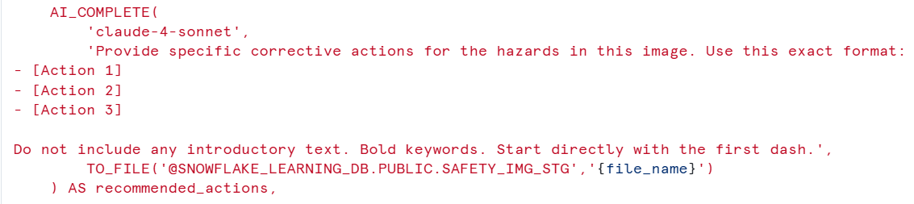
Snowflake AISQL in Action
1
AI_FILTER
Pre-checks to filter non-actionable images
Prevents unnecessary AI processing
Optimizes performance and cost at scale
2
AI_CLASSIFY
Identify multiple hazard categories per image
Supports real-world site hazards (e.g., fire, PPE, electrical, trip risks)
Produces structured labels for analytics and aggregation
3
AI_COMPLETE
Risk score generation (0-10)
Risk explanation
Corrective action recommendations
Site-level prioritized actions (aggregated across images)
Model: Claude 4 Sonnet
Chosen for multi-image site analysis (20 images/prompt) and strong vision reasoning
Model choice is fixed to ensure consistent, comparable, and auditable risk outputs

Slide 7
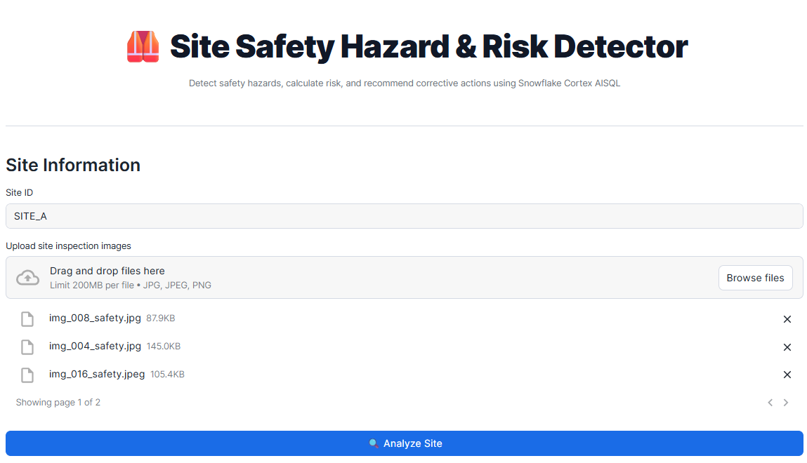
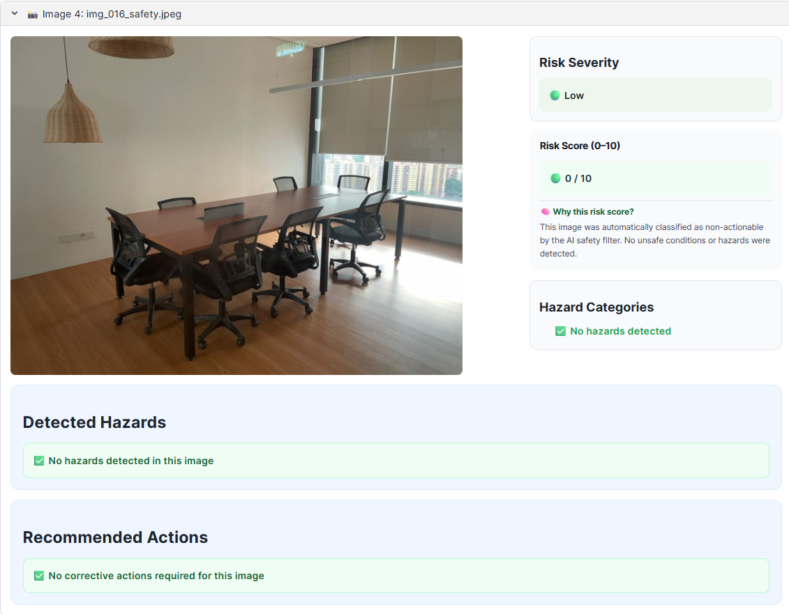
App Demo:
Cost-Aware with AI_FILTER
Image Upload (Input Stage)
Multiple site images uploaded
Stored directly in Snowflake internal stage
No data movement outside Snowflake
Safe Image Result (AI_FILTER Short-Circuit)
Images with no visible hazards are filtered early using AI_FILTER
No downstream AI reasoning is triggered for non-actionable images
Observed results:
Risk score: 0/10
Severity: Low
No hazards detected
No corrective actions generated

Slide 8
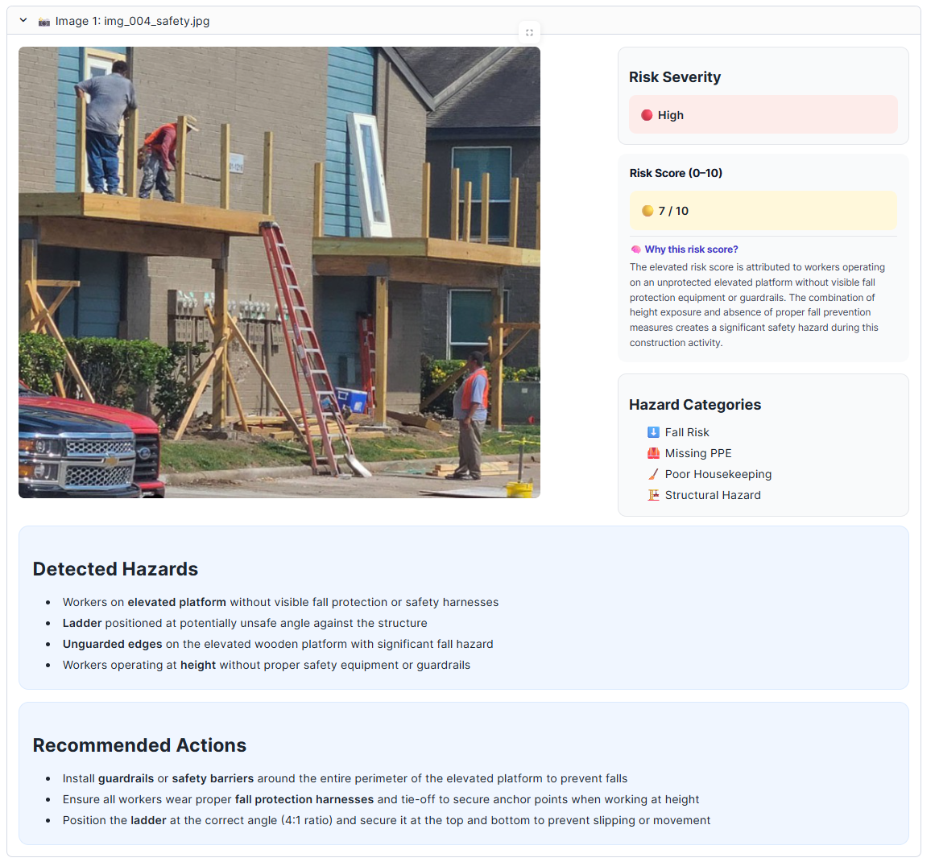
App Demo:
Image-Level Safety Analysis
Hazard Detected → Full AI Analysis
Image is flagged as has potential hazard and proceeds into full AI reasoning
Ensures only actionable images receive deeper analysis
Image-Level AI Outputs
Risk severity and score generated from visible conditions (AI_COMPLETE)
Multiple hazard categories identified per image (AI_CLASSIFY)
Clear explanation provided for audit and reporting (AI_COMPLETE)
Actionable corrective steps recommended (AI_COMPLETE)
Observed results:
Non-zero risk score
Severity level assigned (Low/Medium/High)
Hazards explicitly listed
Corrective actions generated

Slide 9
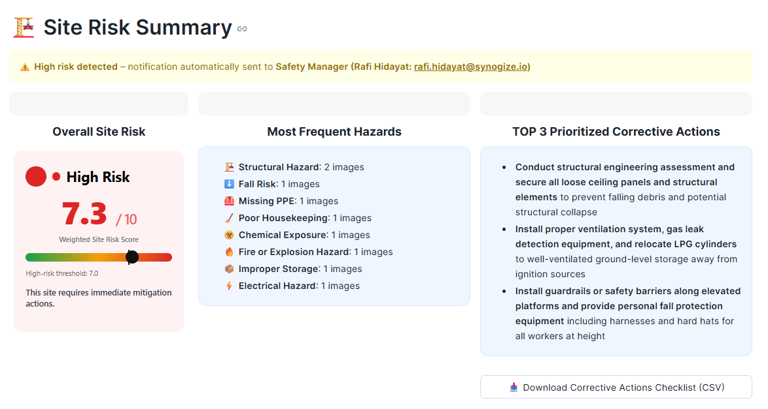
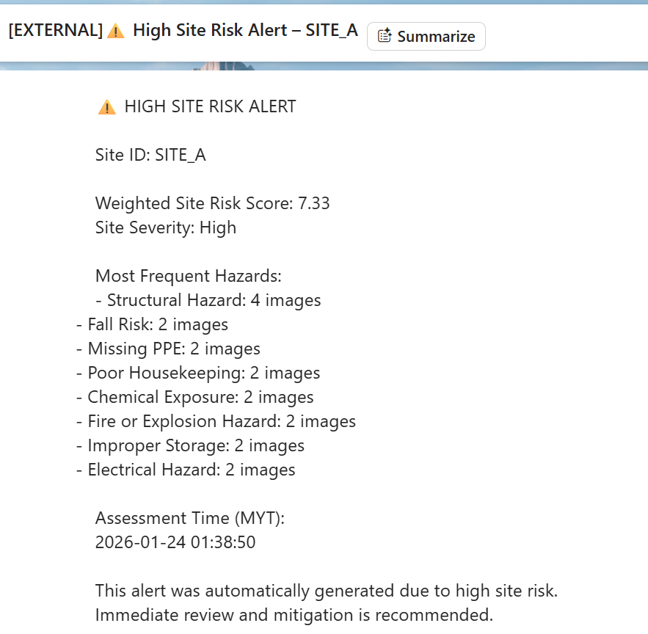
App Demo:
Site-Level Risk Intelligence
Site-Level Aggregation & Scoring
Image-level results are aggregated deterministically into a weighted site risk score
Results are persisted in Snowflake for traceability and audit review
Automated Risk Notifications
High-risk sites automatically trigger email alerts when the site risk score exceeds the defined threshold
Notifications are sent with site risk score, severity, and most frequent hazards
Most Frequent Hazards
Hazard counts are derived directly from AI_CLASSIFY outputs
Prioritized Corrective Actions
Top actions are generated by analyzing:
Hazard frequency
Image-level corrective recommendations
Exportable corrective action checklist (CSV)

Slide 10
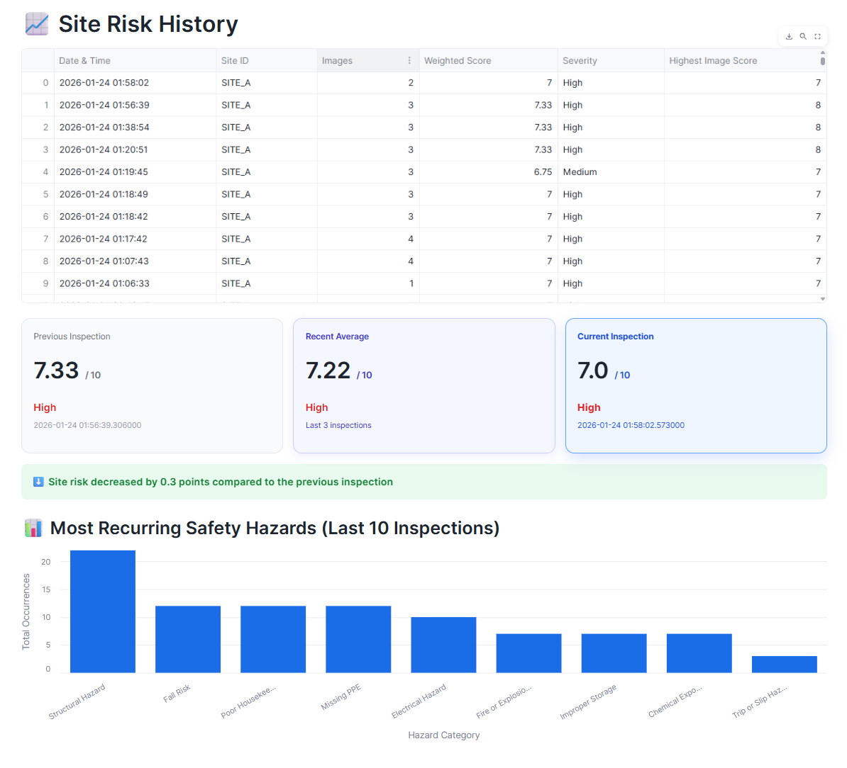
App Demo:
Historical Insights & Trends
Risk History & Trend Tracking
Every site inspection is persisted as a time-stamped record in Snowflake
Enables before/after comparison across inspections
Automatically highlights risk movement (increase or decrease)
Rolling Risk Indicators
Previous inspection: last recorded site risk
Recent average: rolling average of last N inspections
Current inspection: latest site risk score
Recurring Hazard Analysis
Hazard recurrence is calculated from historical AI_CLASSIFY outputs
Helps teams prioritize long-term mitigation, not just fixes

Slide 11
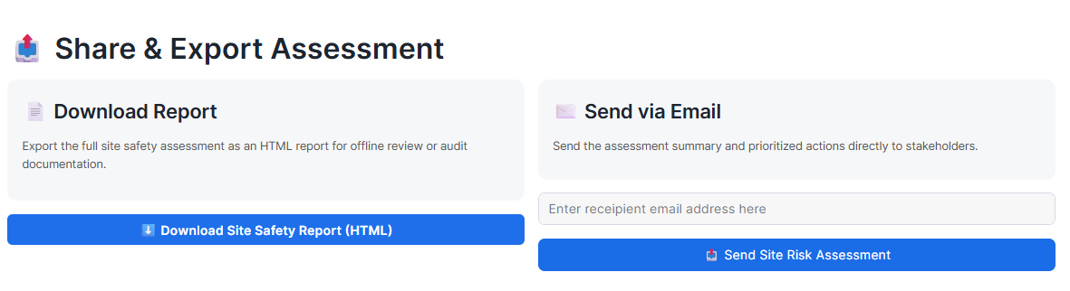
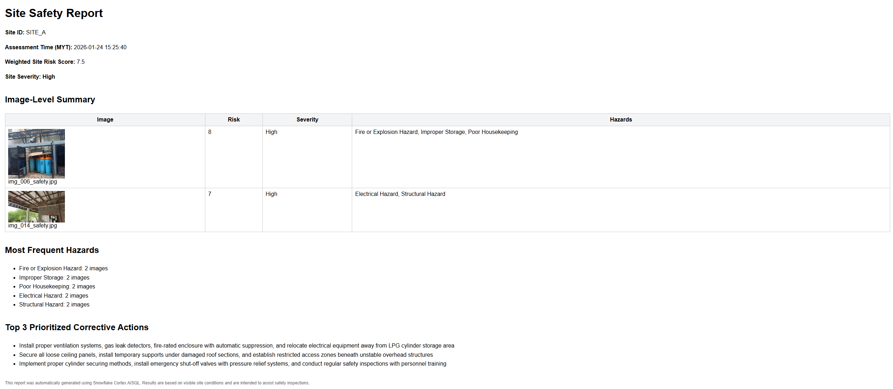
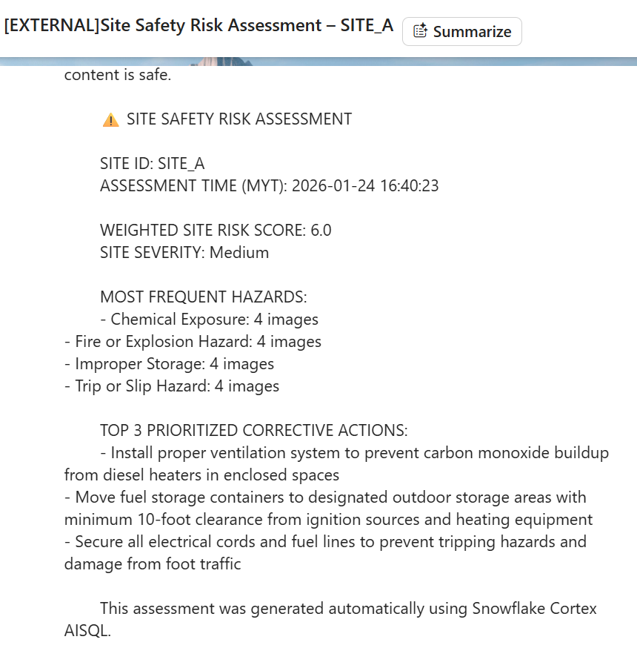
App Demo:
Share & Export Assessment
Exportable Safety Report (HTML)
Full site safety report generated automatically
Includes: Site ID & assessment time, weighted site risk score and severity, Image-level risk breakdown, most frequent hazards, and top 3 prioritized corrective actions
Send Report via Email Option
Site risk assessment can be sent directly via email
Includes: Key risk metrics, most frequent hazards, and prioritized corrective actions

Slide 12

Reflection:
What Worked Well
AISQL enabled clean, auditable and well-governed AI pipeline
All AI reasoning is declarative, traceable, and executed inside Snowflake, with distinctive separation:
Detection (AI_FILTER)
Classification (AI_CLASSIFY)
Reasoning and actions (AI_COMPLETE)
AI_FILTER reduced unnecessary AI calls
Enabled deterministic early short-circuiting for non-actionable images, improving cost efficiency and performance
AI_CLASSIFY enabled consistent multi-label hazard detection
Provided structured and repeatable hazard categorization across images
Enabled site-level aggregation of frequent hazards without additional AI calls
AI_COMPLETE delivered explainable risk scoring and actionable outcomes
Generated image-level risk scores with concise and inspection explanations
Produced practical corrective actions and prioritization using the same declarative AI layer
Seamless Streamlit + Snowflake integration
Delivered an end-to-end pipeline from image ingestion to risk analysis, automated email alerts, and downloadable reports and corrective action checklists fully within Snowflake. No data leaves Snowflake for compliance and audit review

Slide 13
Reflection:
Challenges & Limitations
AI-based image interpretation is probabilistic
Results depend on visual cues, image quality, and model inference
Risk scores and hazard detection are estimates, not deterministic compliance decisions
Potential approaches: Establish clear inspection guidelines and complement AI results with on-site inspections or sensor data where available
AI_COUNT_TOKENS not supported for selected model
End-to-end token consumption for a full-site analysis was not directly measurable using AI_COUNT_TOKENS function, due to current model support limitations of AI_COUNT_TOKENS for AI_COMPLETE when using the selected vision model (Claude 4 Sonnet)
Potential approaches: Evaluate alternative models currently supported by AI_COUNT_TOKENS for AI_COMPLETE (e.g., llama4-maverick, llama-4-scout), with further assessment required on vision capability and output quality
Platform constraints limited some output formats
Report export currently limited to HTML (PDF intended) since generating PDFs requires capabilities are not currently available in Snowflake-hosted Streamlit
Corrective action checklist exported as CSV (Excel intended) since the native Excel generation required external python library packages that are not currently available in Snowflake-hosted Streamlit
Email notifications are restricted to verified recipients as they rely on Snowflake’s native SYSTEM$SEND_EMAIL, which only allows sending to pre-verified email addresses defined in the notification integration
Potential approaches: Leverage alternative Snowflake Container Runtime to use Python library with compiled dependencies or build custom Python UDFs and stored procedures
Not a replacement for certified safety inspections
The system is designed to assist safety inspectors, not replace professional judgement
Final decisions should remain with trained safety officers
Potential approaches: Establish governance (image capture quality, risk thresholds, alert escalation rules)

Slide 14
Business Value & Impact
Faster site inspections
Standardized and scalable risk scoring
Actionable insights for safety managers
Near-real-time risk assessment from images, reducing inspection turnaround time
Consistent, repeatable risk evaluation across inspectors, sites, and time
Clear prioritization of hazards and corrective actions over raw observations
Proactive safety insights from historical data
Automated risk escalation
Auditability & compliance readiness
Centralized inspection history enables trend analysis across sites and time to help identify recurring hazards and prevent incidents before escalating
High-risk sites are automatically escalated through alerts, reducing reliance on manual review
All inspection results, risk scores, and actions are centrally stored and traceable
Net impact: Faster, more consistent safety decisions with built-in governance and auditability, without replacing human judgment

Slide 15

Demo &
Next Steps
1
Role-based views for safety teams
2
Corrective action tracking & closure status
Demo video:
https://youtu.be/CPCsGUesCik
3
Audit-ready exports & regulatory reporting templates
4
Trend-based early warning indicators
Code repository:
https://github.com/rafiaqila/aisql-site-safety-inspection.git
5
Configurable risk thresholds & escalation rules
6
Human-in-the-loop review & feedback

Slide 16
Thank
You!

